Slide 1
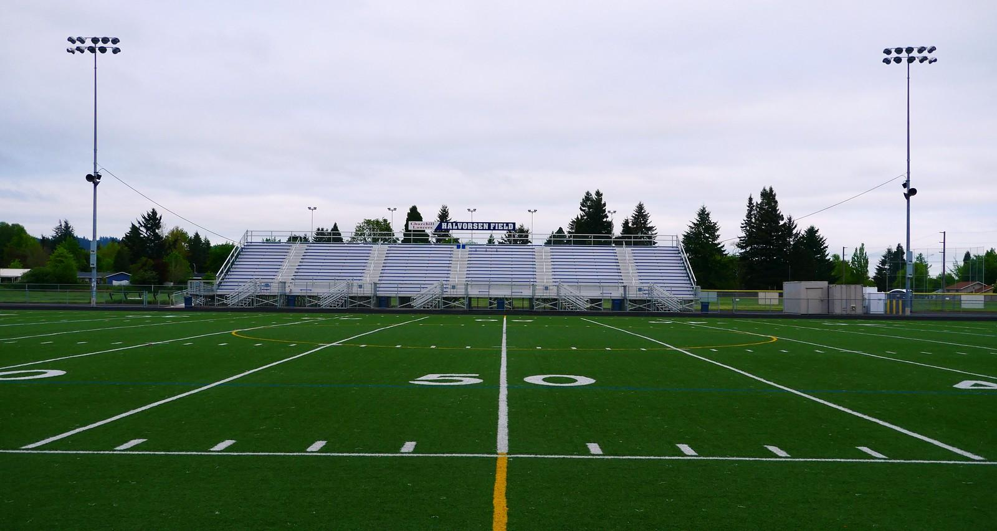

Coaching Youth Football: Developing Defensive Ends, Outside Linebackers, and Inside Linebackers
Techniques and Drills for 5th-8th Grade Players
Mark McAndrews mcandrewsm@wiltonps.org

Slide 2
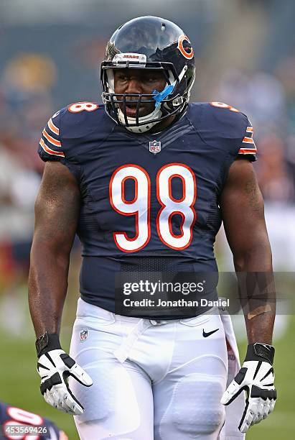
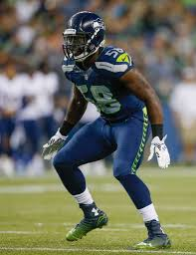
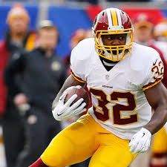
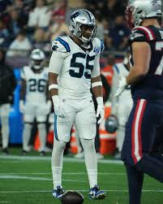
I am a very lucky coach

Slide 3
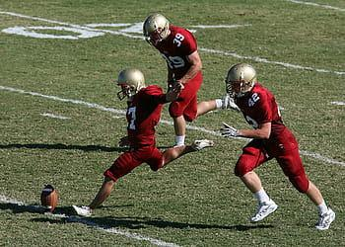
My Goal: Equip coaches with the knowledge and drills to teach defensive fundamentals.
  Know the WHY - Be able to explain the WHY
  Part whole method
Focus Areas:
  Defensive ends (DEs): Pass rush and run-stopping techniques.
  Outside linebackers (OLBs): Edge containment and pass coverage.
  Inside linebackers (ILBs): Gap responsibility and run/pass reads

Slide 4
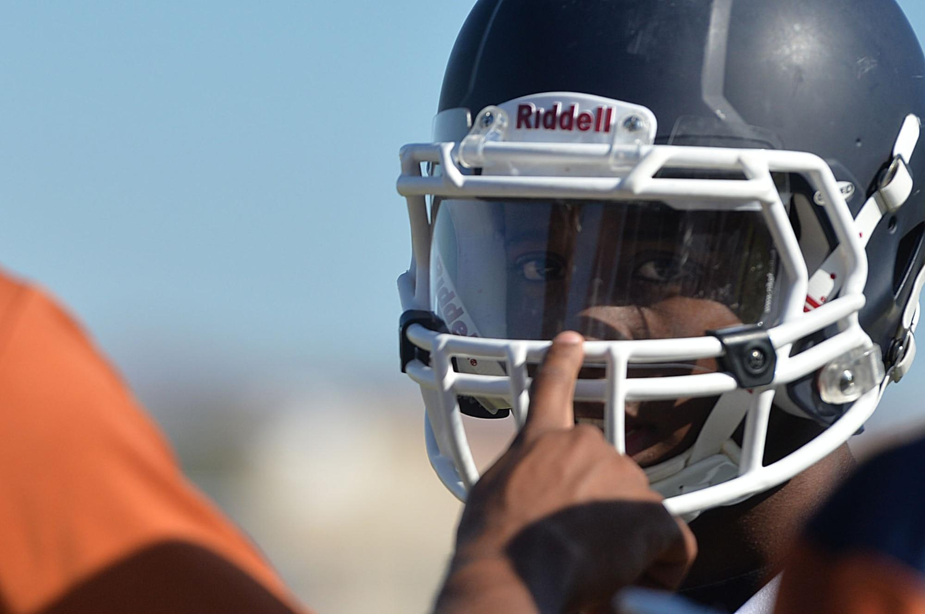
Know your personnel (KYP)
What Kind of players/learners do you have?
Aggressive
Street smart
Book smart
Timid
Strong
Tight (hip flexion)
Hyperactive short tension span
Lacking motivation
Visual learner
Auditory learners (need a playbook and directions on paper)
Needs gentle reminders
Needs command style

Slide 5
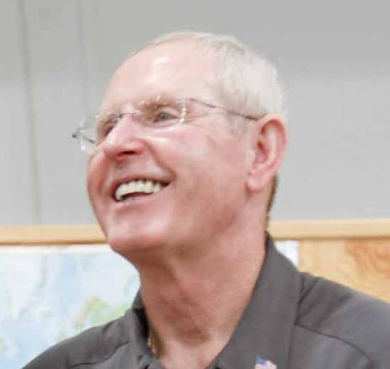
It’s a lot easier for you to adapt to the players
Build their mental toughness
Figure out what motivates them individually and as a team
What triggers them to shut down or retreat.build that into practice to practice overcoming the obstacle
Once you really know the player, don’t be afraid to push them past their comfort zone.
Be hard on them in practice. Discipline, Grind, Build their physical and mental toughness
Try to be a calm leader in games. If you panic they panic, if you lose control they lose control. If your having fun and enthusiastic the kids will mimic it. Talk to them with calm specific facts not emotion.
https://youtu.be/8guX2A0LASI?feature=shared

Slide 6
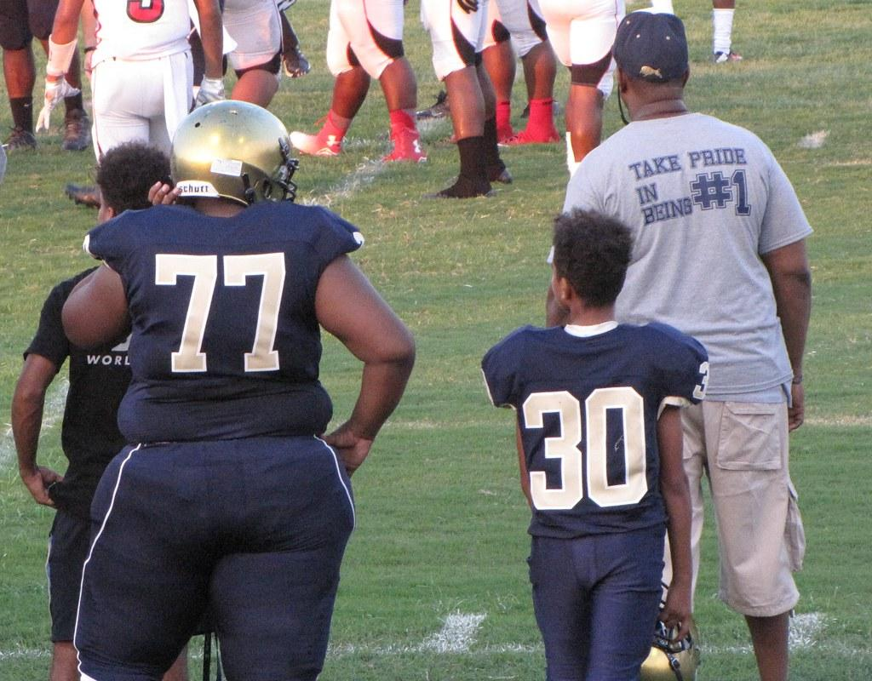
Positioning your players
DE/OLB – Speed, discipline, understanding of leverage (pad level and outside contain), good tacklers, good hand fighting skills
ILB’s – Physically tough, strong, disciplined eyes, understands leverage to take on blocks with hands and fill holes at the LOS
D- Line – The most versatile position on the field at the youth level. Someone that won’t run into a blocker and allow themselves to be pushed backwards. Speed or size or both, discipline, understanding of leverage, good tacklers, good hand fighting skills
Corners – Speed, discipline, understanding of leverage, good tacklers, good hip mobility for coverage
Safety - Speed, discipline, good vision, film study, good tacklers, good hip mobility for coverage. My assistant coach on the field

Slide 7
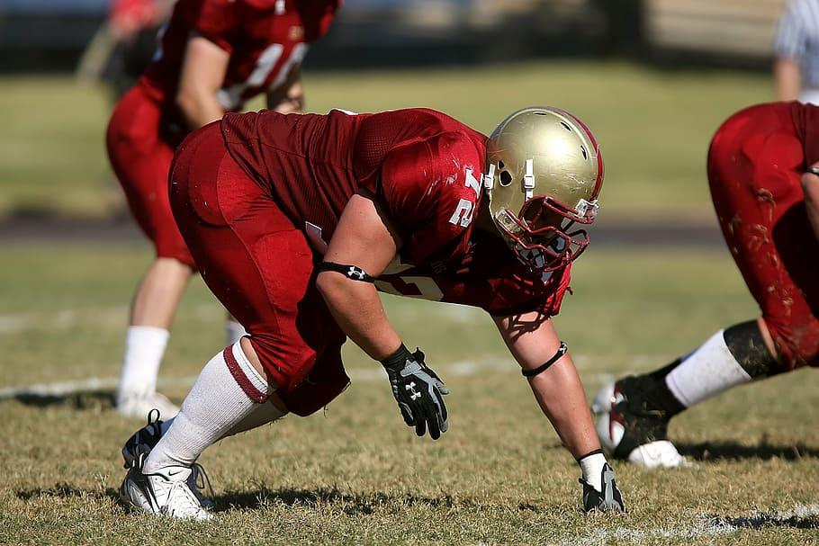
Defensive Ends (DE) Role Overview
Key Responsibilities:
  Contain the edge to prevent outside runs.
  Rush the passer.
  Engage and shed blockers with multiple moves.

Slide 8
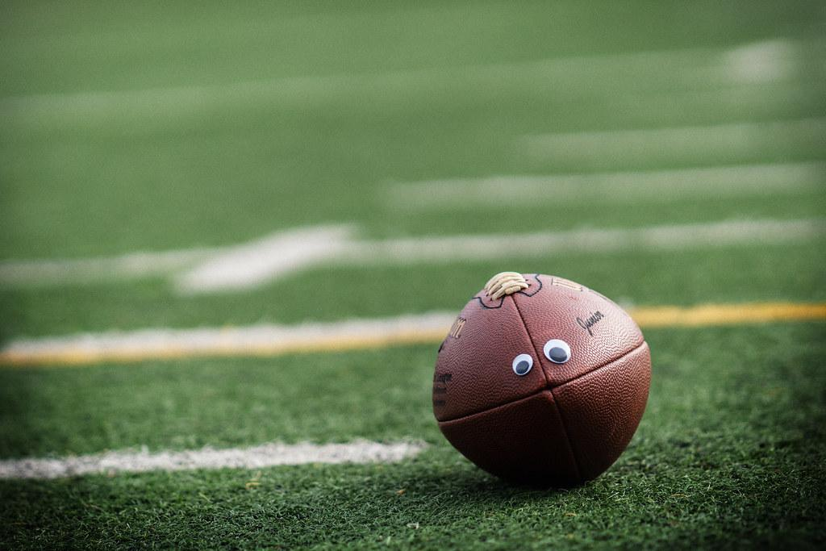
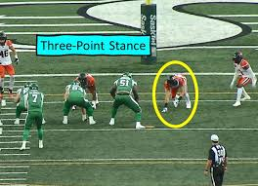
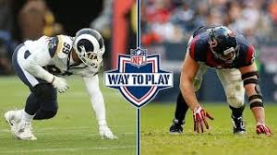
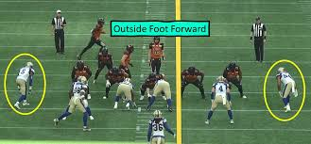
DE Stance and Alignment
Key Points:
  Feet shoulder-width apart, knees bent and feet under your body.
  Weight forward
  Hands ready to engage. Get him before he gets you
  Attack half the man
    Never get in between his shoulder pads
Drill: "Get-Off Drill"
  Start in stance; use a shoot and go through progressions of getting out of your stance and attacking half a man with proper leverage and hand placement with footwork.
  https://youtu.be/HGffas3SS0s?feature=shared

Slide 9
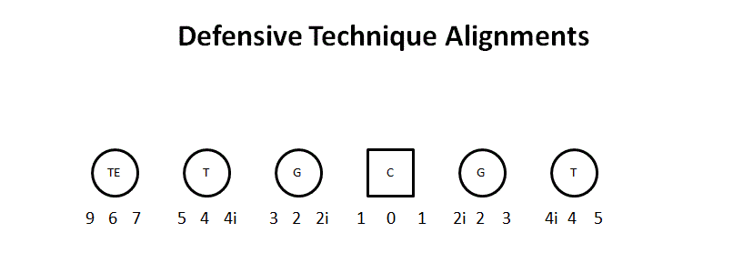
D C B A A B C

Slide 10
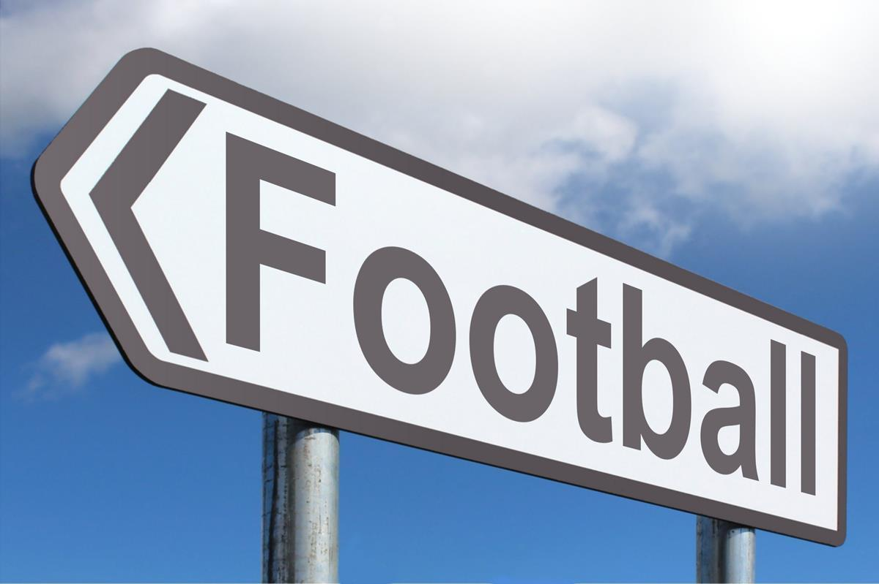
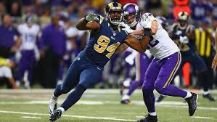
DE Techniques
Key Techniques: Attack Half the man!!!
  Rip Move https://youtu.be/21Sg4vDSCnM?feature=shared
  Slingshot https://youtu.be/ZO2i2SZzwY8?feature=shared
  Bull Rush https://youtu.be/t4AdHCytc4o?feature=shared
Drill: "Bag Rush Drill"
  Players use technique to get past a bag.
  1v1’s
  1v1’s to a pop up dummy

Slide 11
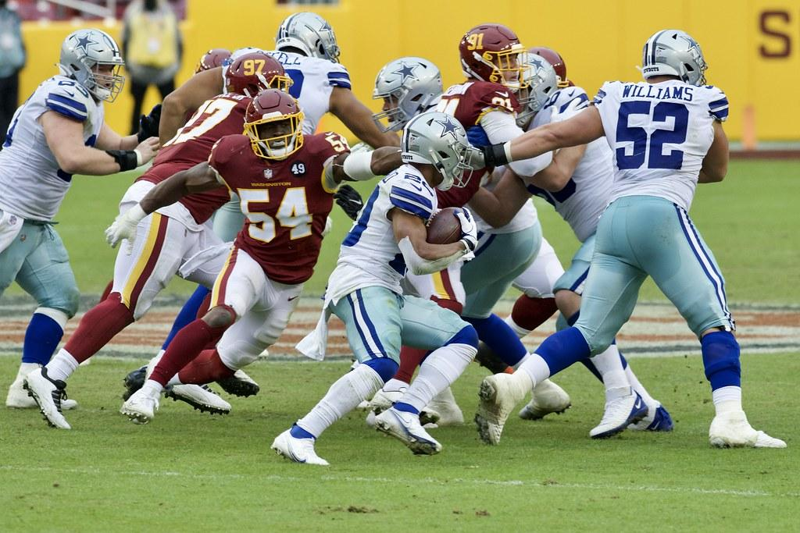
Inside Linebackers (ILB) Role Overview
Key Responsibilities:
  Read and react to the play.
  Fill gaps to stop runs. (SHOCK AND SHED)
  Cover short passes (hook to curl or man-to-man).

Slide 12

ILB Stance and Reads
Key Points:
  Square stance, weight balanced.
  Eyes on the backfield.
  Read and react to offensive linemen first steps.
  Meet the back at the LOS
Drill: "Shock and Shed"
  Coach signals run/pass; player reacts.
https://youtu.be/G_5OF4gIzrY?feature=shared

Slide 13
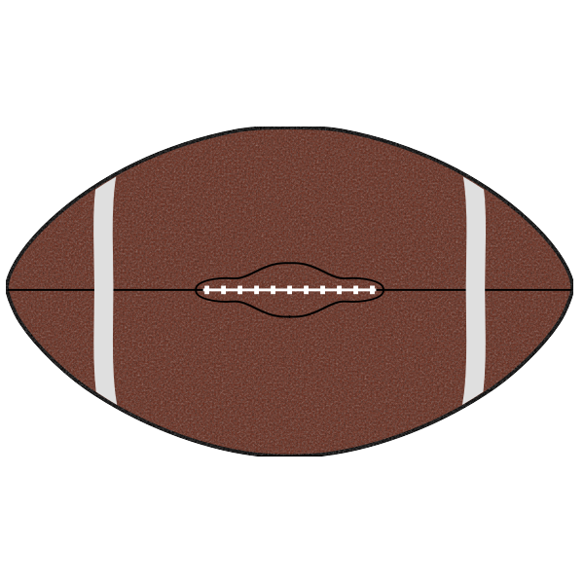
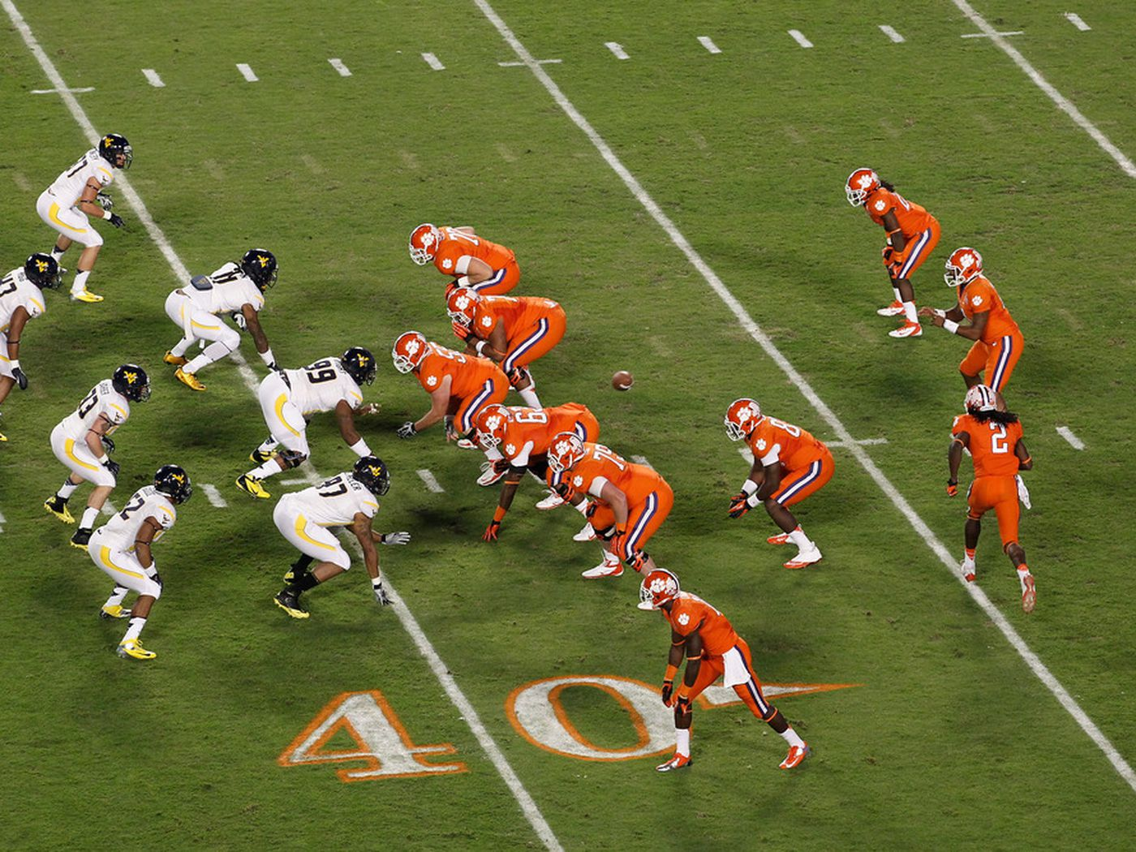
ILB Techniques
Key Techniques:
  Gap responsibility.
  Triangle read.
  Short-zone coverage.
Drill: "read and react"
  Players align; on snap, read the guards through to the back and react.
https://youtube.com/shorts/IUAO4f6TwDk?feature=shared

Slide 14
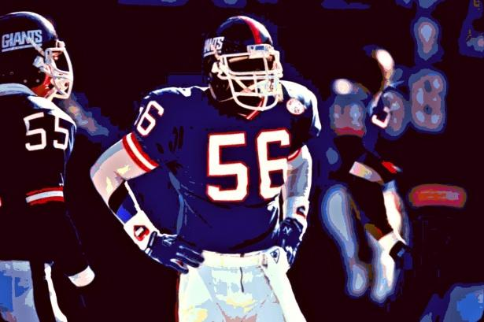
Outside Linebackers (OLB) Role Overview
Key Responsibilities:
  Contain the run outside the tackle.
  Drop into pass coverage (flat zone or man coverage).
  Support the pass rush.

Slide 15
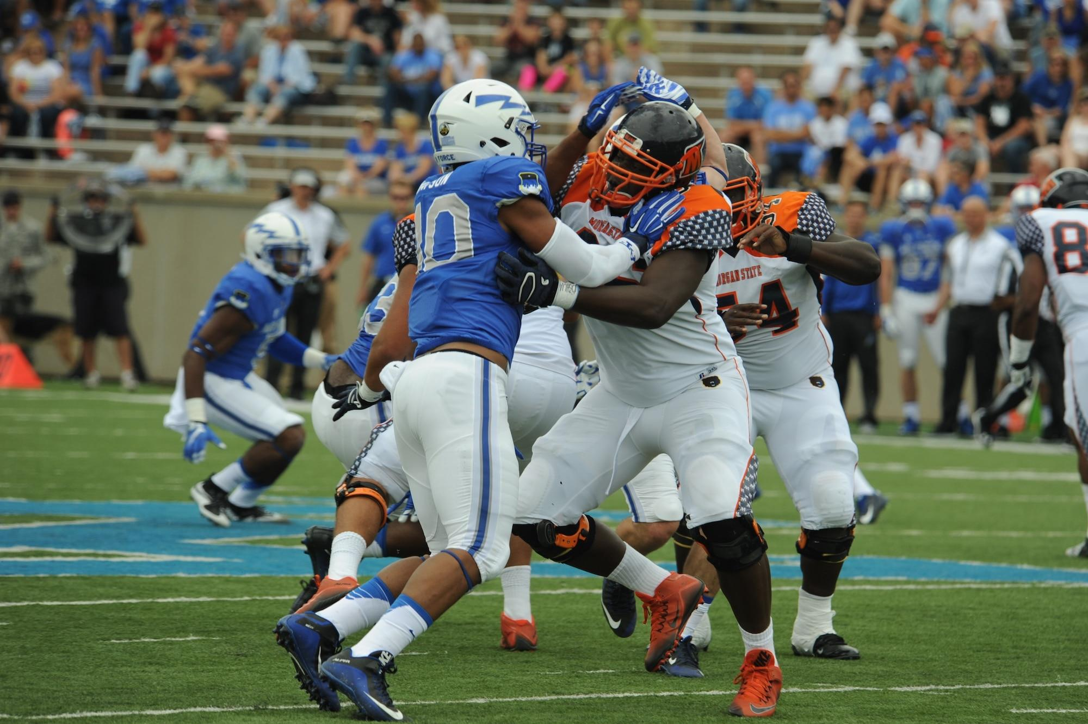
OLB Stance and Movement
Key Points:
  Feet slightly wider than shoulder-width.
  Hands free and ready.
  Eyes on the ball.
Drill: "Run Pass read drills/footwork"
  Establish run/pass recognition and footwork to make proper reads and not guessing
  https://youtu.be/WbD8EU6iLWM?feature=shared

Slide 16

OLB Techniques
Key Techniques:
  Attacking outside shoulder
  Shedding blocks.
  Zone coverage drops.
  Open-field tackling.
Drill: "read react pursuit drill"
  Set up bags; player takes read steps and adjust through bags and ends with tackling pop up dummy.
  https://youtu.be/kq5e6imIiI0?feature=shared

Slide 17

HS coaches wish list
Disciplined Player
  Attitude
  Effort
  Eyes
Knows proper stance and starts
Understands pad leverage
Good form tackling
  Eyes through thighs
  Attack neer hip
  Wrap legs

Slide 18
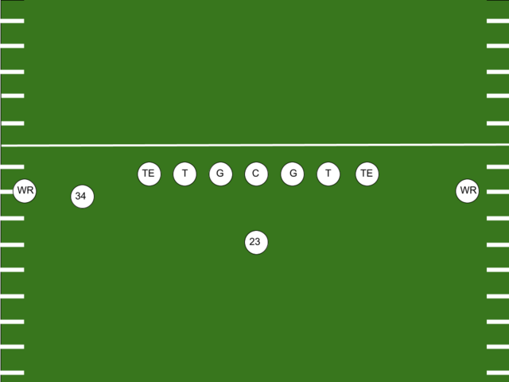
Extra coaching tips - Game Situation Drills
Third down scenarios
Red zone defense
Goal line stands
Two-minute drill

